Slide 1

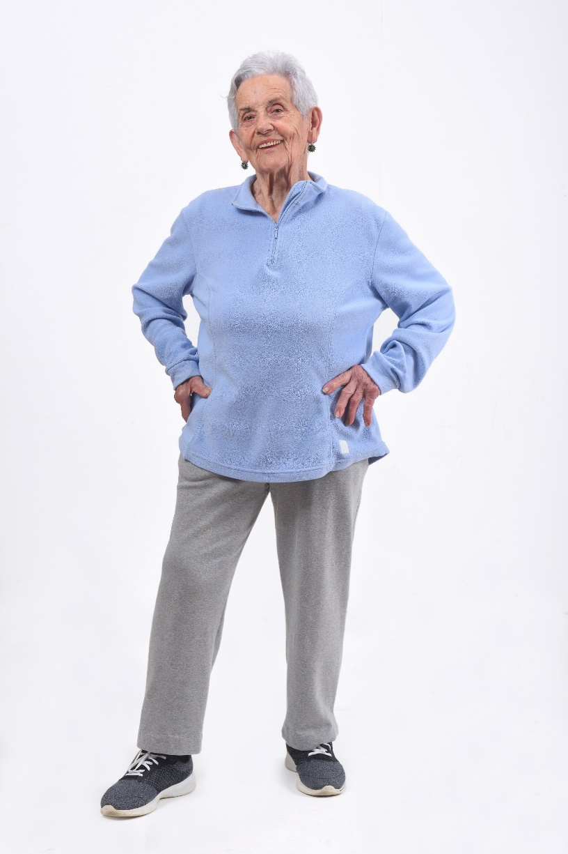



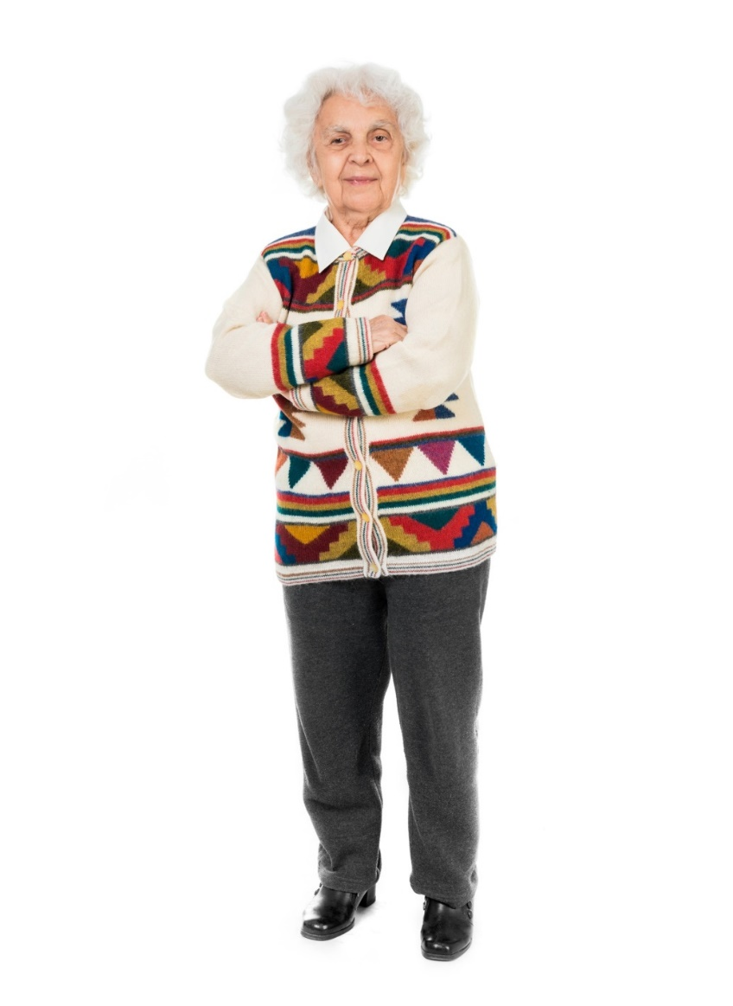

Case 9
CASE 5
Optimizing The Use and Dosing of DOACs in Patients with AF

